Slide 1

CREDIT RISK ANALYSIS
EDA CASE STUDY
BY:
ANUP KUMAR

Slide 2

PROBLEM STATEMENT
Understanding driver variables behind loan default and finding out which variables are strong indicators of a future default.
This is achieved by using EDA (Exploratory Data Analysis) on the bank data, wherein we analyze the pattern present in data and help bank in mitigating two types of risk associated with loan approvals:
If the applicant is likely to repay the loan, then not approving the loan results in a loss of business to the company
If the applicant is not likely to repay the loan, i.e. he/she is likely to default, then approving the loan may lead to a financial loss for the company

Slide 3
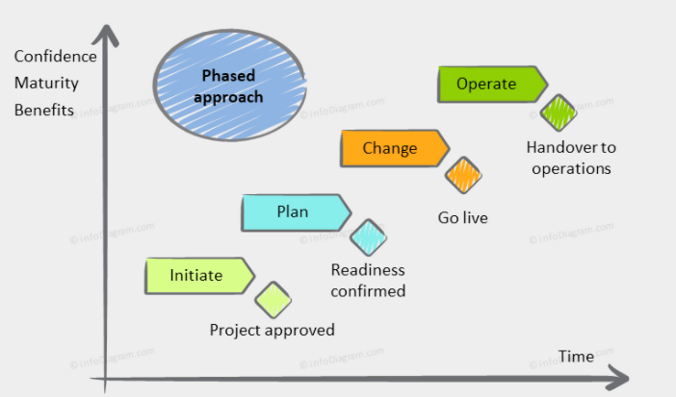

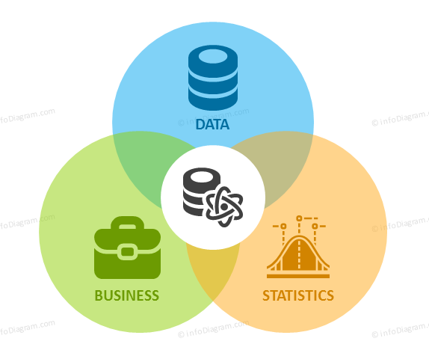


APPROACH
Importing and cleaning of provided data
Formatting or Grouping for an effective analysis
Performing Univariate & Bivariate analysis on categorical and Numerical fields
Draw useful Insights

Slide 4
DATA CLEANING
Dropping all columns with 50% and above null values
Further dropping columns with 15% and above null values if they are not important with reference to out analysis
Checking for outliers in important numerical columns
Based on data dictionary further identifying the columns which are not required for our analysis and hence dropping them
DAYS_EMPLOYEED have a very high positive value which is not possible and hence replaced by null
DAYS columns have negative values and hence all have changed to absolute number
Few columns have ‘XNA’ or ‘XAP’ and hence need to be imputed

Slide 5

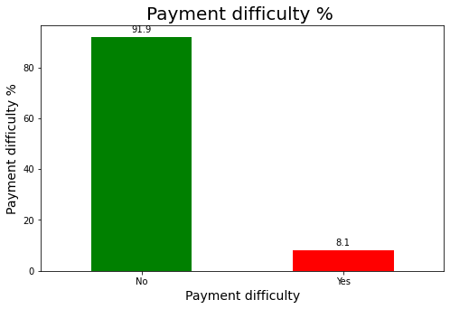
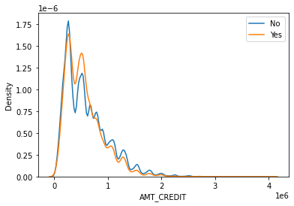
APPLICATION DATA
Contains information of the client at the time of loan application. The data captures whether a client has payment difficulties
Almost 92% of the clients don’t have any payment difficulties
As the loan amount increases, the number of people returning to the bank also increases. Hence, bigger loans seems to be safer for banks

Slide 6

DATA BINNING & FORMATING
Columns 'AMT_INCOME_TOTAL‘ and ‘AMT_CREDIT’, which are continuous variable. New categorical columns have been created 'AMT_INCOME_RANGE‘ and ‘AMT_CREDIT_RANGE’ using quantiles for better analysis
Column ‘DAYS_BIRTH’ has been converted in years and then a new categorical column has been created using it for better analysis

Slide 7

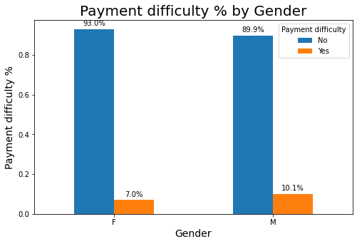
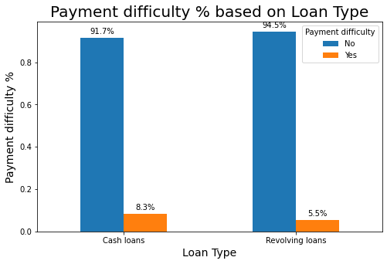
UNIVARIATE ANALYSIS -1
Comparing the Payment Difficulties and Non Payment Difficulties on the basis of Gender, we observe that Females are the majority in both the cases although there is an increase in the percentage in Male from Non-Payment Difficulties
We can observe that cash loans are preferred by both Loan Payment Difficulties and Loan-Non Payment Difficulties although there is a decrease in the percentage of Payment Difficulties who opt for revolving loans.

Slide 8
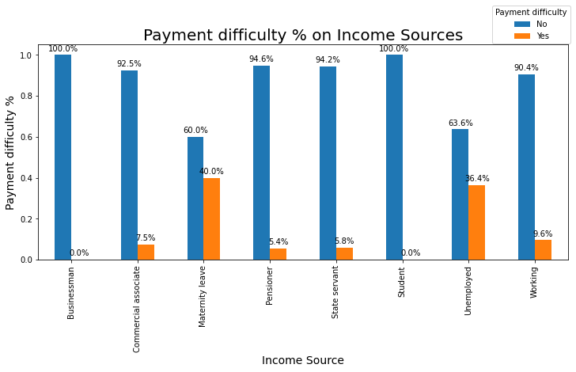
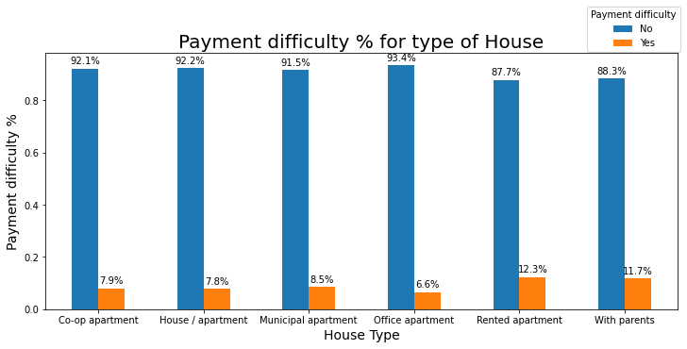
UNIVARIATE ANALYSIS -2
We observe that Businessman and Student have no payment difficulties where as Maternity leave and Unemployed have highest % of payment difficulties. Also, decrease in the percentage of Payment Difficulties for pensioner has been observed as compared to applicants who are working.
We observe an increased percentage of Loan Payment Difficulties who live in Rented apartment and with parents and a decreased percentage of Loan Payment Difficulties who live in Office apartment.

Slide 9
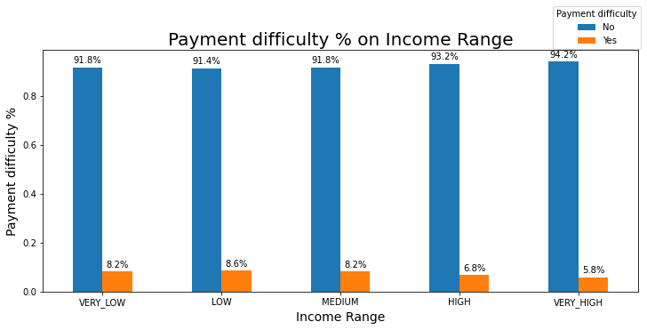
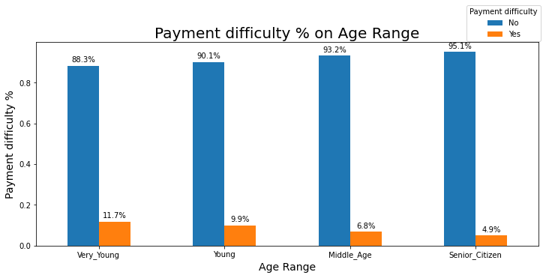
UNIVARIATE ANALYSIS -3
We observe an increased percentage of Loan Payment Difficulties whose income is very low and medium
We observe that there is an increase in the percentage of Loan Payment Difficulties who are young in age. In another word there is indirect correlation between age and payment difficulty %.

Slide 10
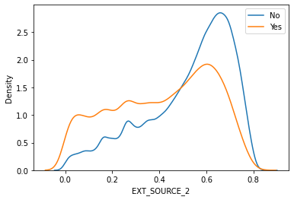
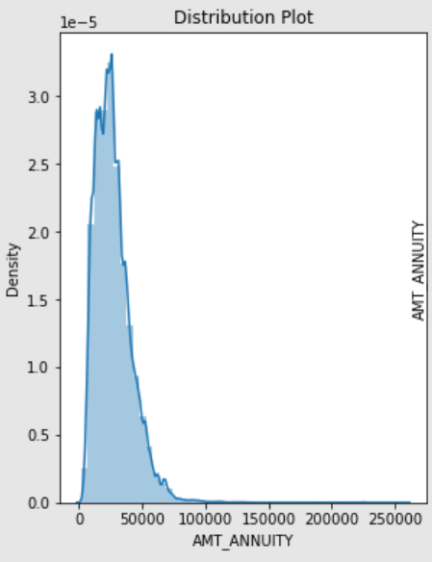
UNIVARIATE ANALYSIS -4
The better the external score of the applicant, the lesser is the payment difficulties.
Most people pay annuity below 50K for the loans.

Slide 11
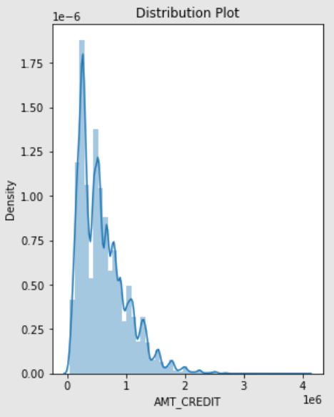
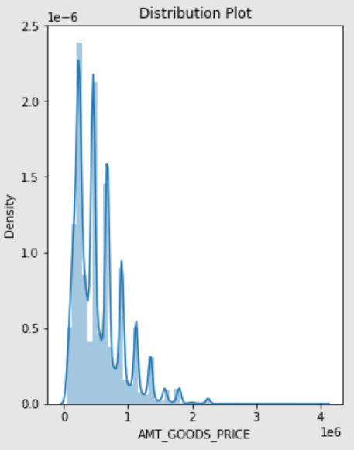
UNIVARIATE ANALYSIS -5
Credit amount of the loan is mostly less then 10 lakhs
Most number of loans are given for goods price below 10 lakhs.

Slide 12
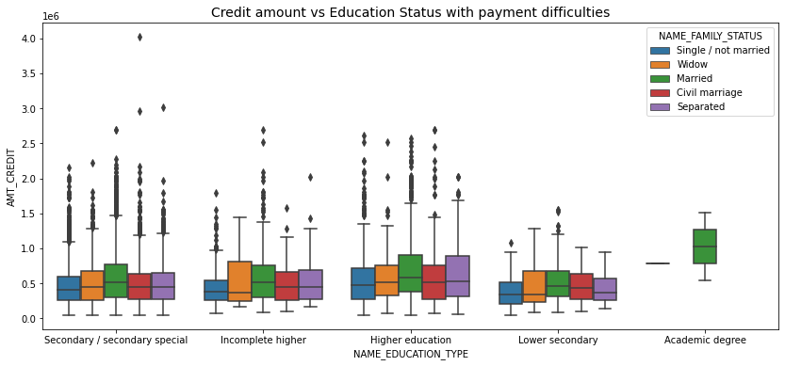
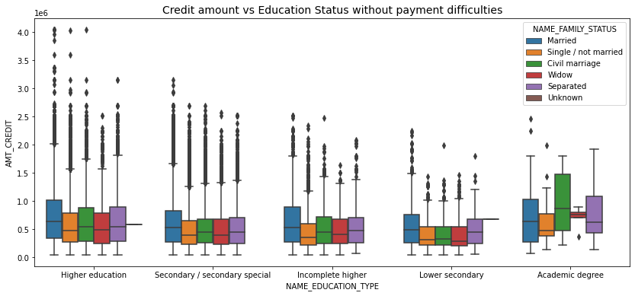
BIVARIATE ANALYSIS -1
Applicants without payment difficulties
Applicants with payment difficulties
Applicants with Academic degree have no outliers and only Married people face payment difficulties
In Married category, people with higher loan amount are less likely to have payment difficulties

Slide 13
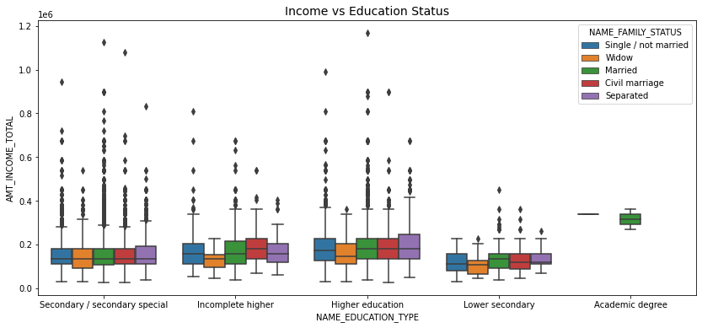
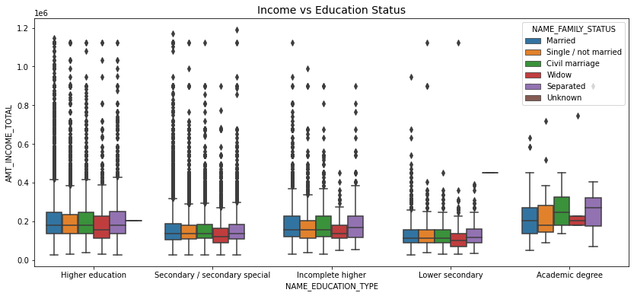
BIVARIATE ANALYSIS -2
Applicants without payment difficulties
Applicants with payment difficulties
Have some similarity with no payment difficulties, From above boxplot for Education type 'Higher education' the income amount is mostly equal with family status.
Less outlier are having for Academic degree but there income amount is little higher that Higher education.
Lower secondary are have less income amount than others.

Slide 14
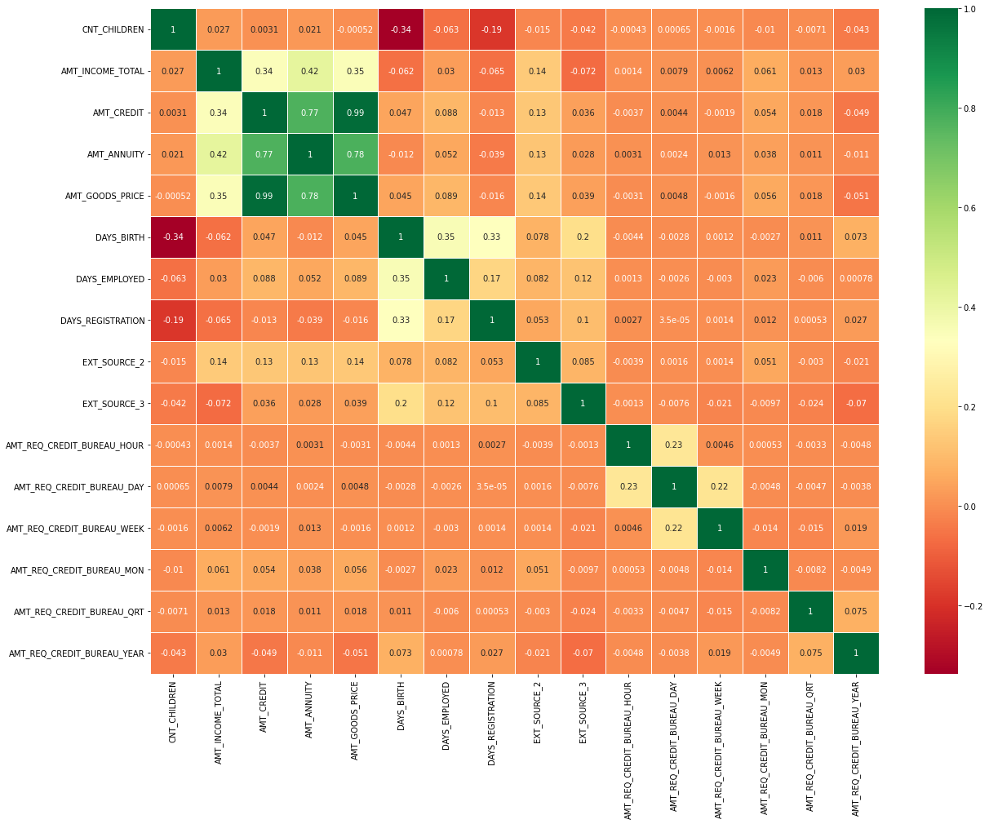
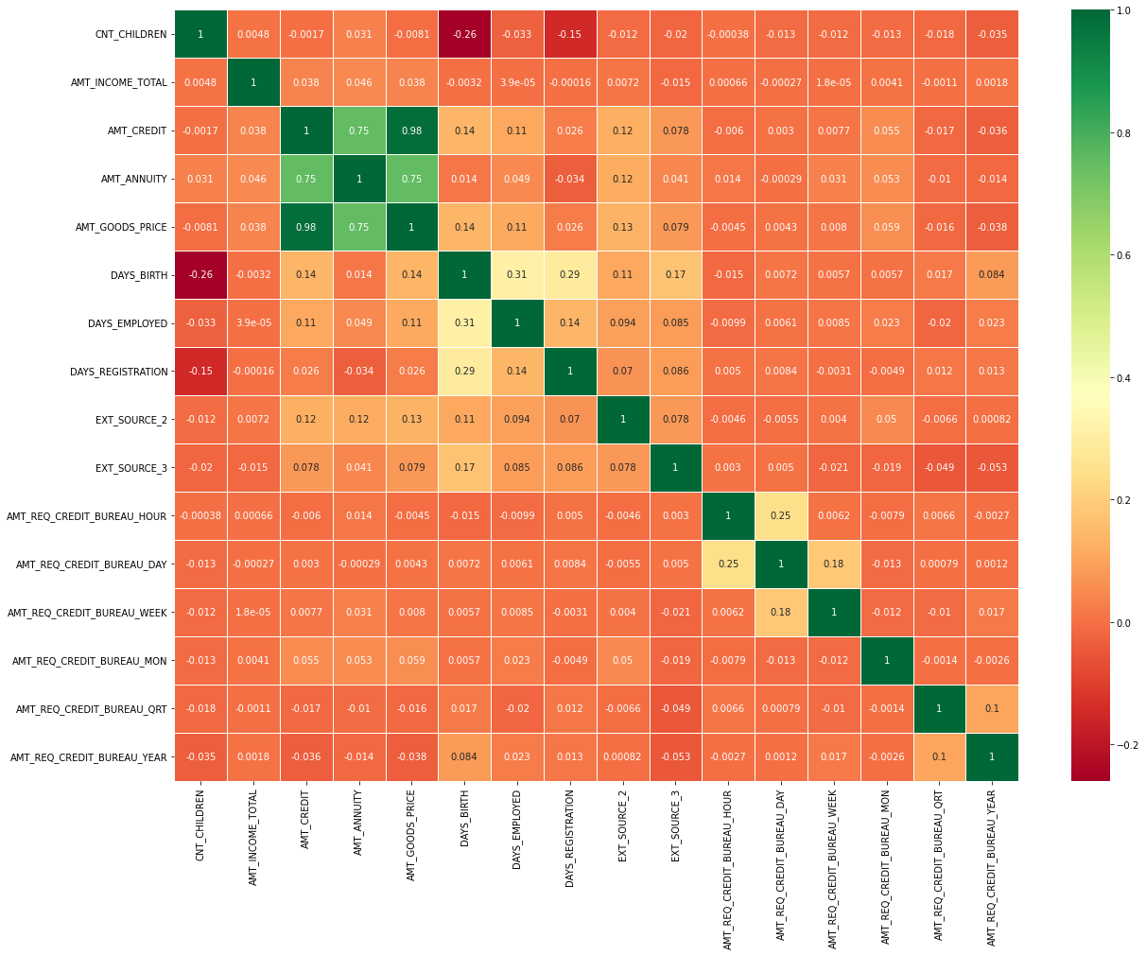
CORRELATION HEATMAP
Applicants without payment difficulties
Applicants with payment difficulties
Credit amount is highly correlated with good price amount which is same as re-payers.
Loan annuity correlation with credit amount has slightly reduced in defaulters(0.75) when compared to re-payers(0.77)
We can also see that re-payers age have high correlation in number of days employed(0.35) when compared to defaulters(0.31).
The correlation between total income of the client and the credit amount(0.33) amongst defaulters whereas it is (0.37) among re-payers.
Days_birth and number of children correlation has reduced to 0.26 in defaulters when compared to 0.34 in re-payers.
Credit amount is highly correlated with:
Goods Price Amount
Loan Annuity
Total Income
We can also see that re-payers have high correlation in number of days employed.

Slide 15
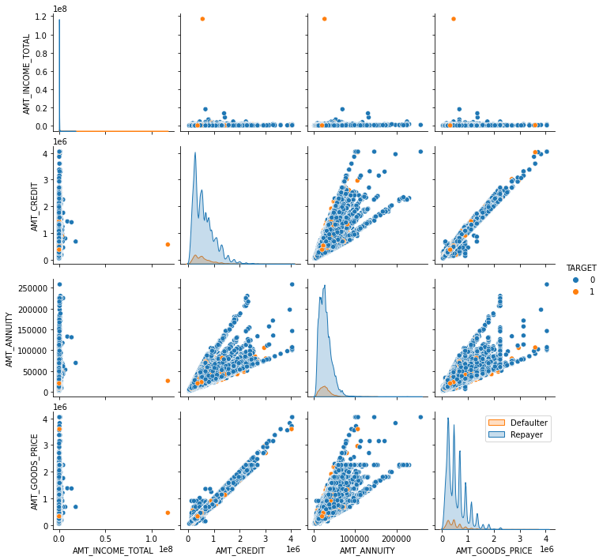
PAIRPLOT AGAINST LOAN REPAYMENT STATUS
When Annuity Amount > 15K and Good Price Amount > 20 Lakhs, there is a lesser chance of defaulters
Loan Amount(AMT_CREDIT) and Goods price(AMT_GOODS_PRICE) are highly correlated as based on the scatterplot where most of the data are consolidated in form of a line
There are very less defaulters for AMT_CREDIT >20 Lakhs

Slide 16
MERGED DATAFRAME ANALYSIS
Merged both dataframes on SK_ID_CURR with Inner Joins

Slide 17
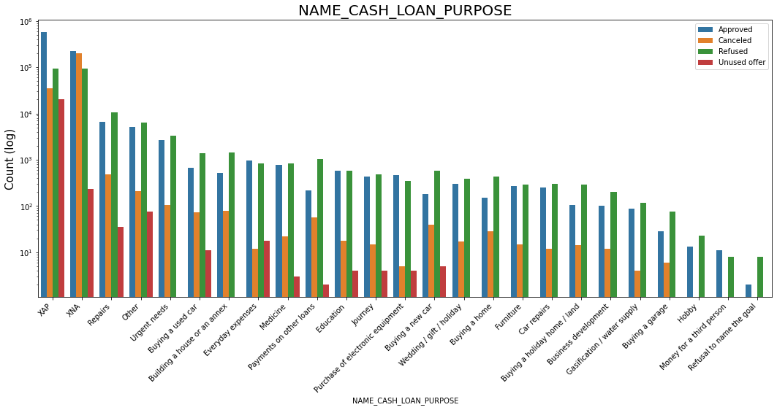
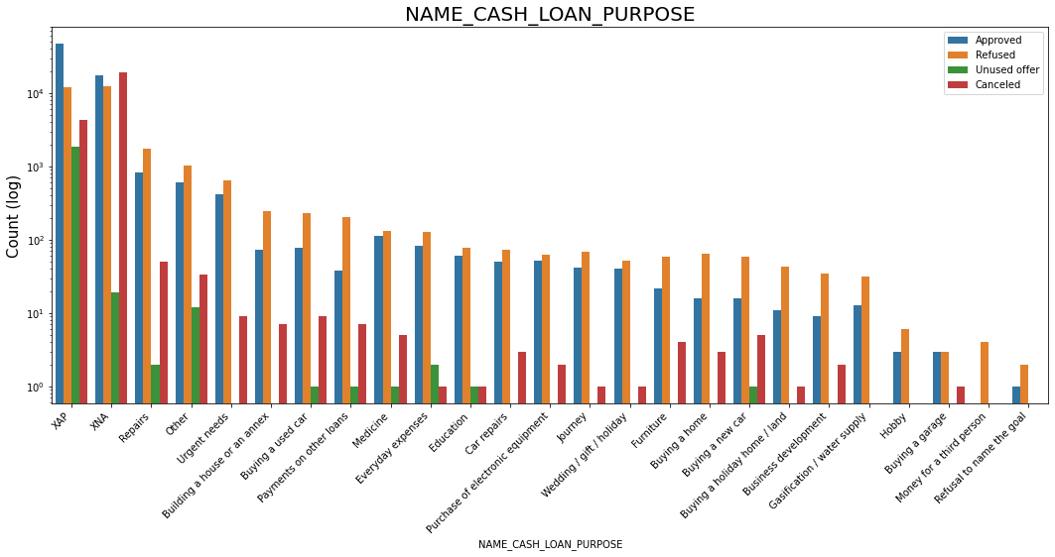
PLOTING CONTRACT STATUS vs PURPOSE OF LOAN
Applicants without payment difficulties
Applicants with payment difficulties
Loan purpose has high number of unknown values (XAP, XNA)
Loan taken for the purpose of Repairs looks to have highest default rate
Huge number application have been rejected by bank or refused by client which are applied for Repair or Other. from this we can infer that repair is considered high risk by bank. Also, either they are rejected or bank offers loan on high interest rate which is not feasible by the clients and they refuse the loan.

Slide 18
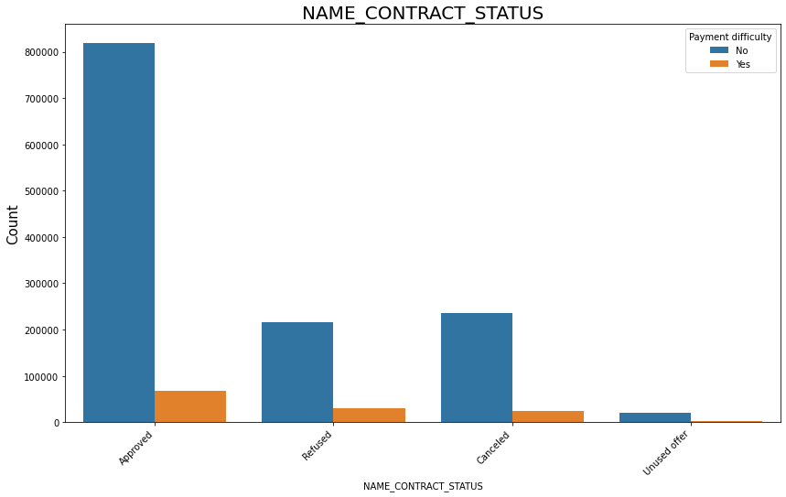
CONTRACT STATUS BASED ON LOAN REPAYMENT STATUS
90% of the previously cancelled client have actually repayed the loan. Revising the interest rates would increase business opportunity for these clients
88% of the clients who have been previously refused a loan has payed back the loan in current case.
Refusal reason should be recorded for further analysis as these clients could turn into potential repaying customer.

Slide 19
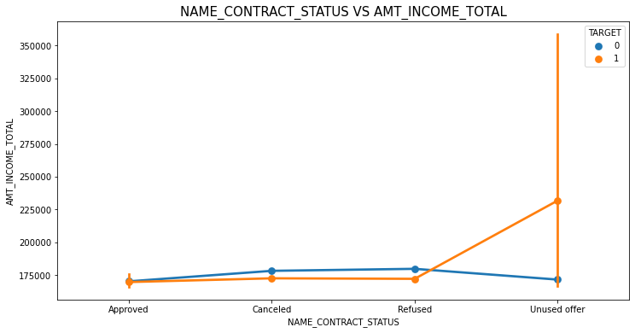
CONTRACT STATUS BASED ON INCOME
The point plot show that the people who have not used offer earlier have defaulted even when there average income is higher than others

Slide 20

CONCLUSIONS -1
After analyzing the datasets, there are few attributes of a client with which the bank would be able to identify if they will repay the loan or not. The analysis is consisted as below with the contributing factors and categorization:
A. Decisive Factor whether an applicant will be Repayer:
NAME_EDUCATION_TYPE: Academic degree has less defaults.
NAME_INCOME_TYPE: Student and Businessmen have no defaults.
ORGANIZATION_TYPE: Clients with Trade Type 4 and 5 and Industry type 8 have defaulted less than 3%
DAYS_BIRTH: People above age of 50 have low probability of defaulting
DAYS_EMPLOYED: Clients with 40+ year experience having less than 1% default rate
AMT_INCOME_TOTAL:Applicant with Income more than 700,000 are less likely to default
B. Decisive Factor whether an applicant will be Defaulter:
CODE_GENDER: Men are at relatively higher default rate
NAME_FAMILY_STATUS : People who have civil marriage or who are single default a lot.
NAME_EDUCATION_TYPE: People with Lower Secondary & Secondary education
NAME_INCOME_TYPE: Clients who are either at Maternity leave OR Unemployed default a lot.
OCCUPATION_TYPE: Avoid Low-skill Laborers, Drivers and Waiters/barmen staff, Security staff, Laborers and Cooking staff as their default rate is huge.
ORGANIZATION_TYPE: Organizations with highest percent of loans not repaid are Transport: type 3 (16%), Industry: type 13 (13.5%), Industry: type 8 (12.5%) and Restaurant (less than 12%). Self-employed people have relative high defaulting rate, and thus should be avoided to be approved for loan or provide loan with higher interest rate to mitigate the risk of defaulting.
DAYS_BIRTH: Avoid young people who are in age group of 20-40 as they have higher probability of defaulting
DAYS_EMPLOYED: People who have less than 5 years of employment have high default rate.
AMT_GOODS_PRICE: When the credit amount goes beyond 3lakhs, there is an increase in defaulters.

Slide 21
CONCLUSIONS -2
C. Factors that Loan can be given on Condition of High Interest rate to mitigate any default risk leading to business loss:
NAME_HOUSING_TYPE: High number of loan applications are from the category of people who live in Rented apartments & living with parents and hence offering the loan would mitigate the loss if any of those default.
AMT_CREDIT: People who get loan for 3-6 Lakhs tend to default more than others and hence having higher interest specifically for this credit range would be ideal.
AMT_INCOME: Since 90% of the applications have Income total less than 3Lakhs and they have high probability of defaulting, they could be offered loan with higher interest compared to other income category.
D. Suggestions:
90% of the previously cancelled client have actually repayed the loan. Record the reason for cancellation which might help the bank to determine and negotiate terms with these repaying customers in future for increase business opportunity.
88% of the clients who were refused by bank for loan earlier have now turned into a repaying client. Hence documenting the reason for rejection could mitigate the business loss and these clients could be contacted for further loans.

Slide 22


